Slide 1
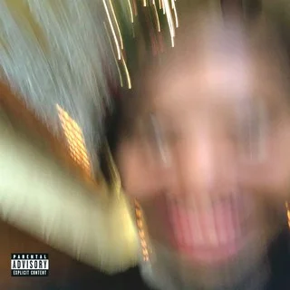
Textual lineage of “Some Rap Songs” by Perry Stephano

Slide 2
Overview
This is Earl Sweatshirts third album to release and it came three years after his last album came out. After multiple delays it was released on November 30th, 2018.
He is the son of teacher and writer Cheryl Harris and South African poet Keorapste Kgositsile. He had planned to surprise his father with this album to fix their relationship but sadly he passed away on January 3rd, 2018.
On this projeEarl raps about how he dealt with his depression and reflects on his life.

Slide 3
“Shattered Dreams”
The first thing we hear as soon as you start listening to to album is a sample of James Baldwin saying “Imprecise words”. This comes from a speech Baldwin did in 1962 called “The Artist Struggle for Integrity”. Baldwin speaks about how hard it is for artist to make art that they feel has meaning.
Imprecise words is taken from a quote where Baldwin says he doesn't like words like artist, integrity, courage and ability and that they are used to get to something real and meaningful. At the end Baldwin says the only thing he’ll be fine being called is artist although he doesn't like it.
Earl uses this because he wants to be known for more than just being a rapper. He wants his music to be more than just music. He wants to tell his story and he wants to help people who have been in similar positions as him.

Slide 4
“December 24th”
The intro to this track comes comes from “The Dialect of Black Americans”. It is a speech from 1970 and Earl uses a quote from it saying how slang should be recognized as a genuine dialect of english.
Earl used this quote because he uses slang but he's still a very smart person. He feels that people who use slang should not be looked down on and since it feels like everyone nowadays uses slang it shouldn't be seen as bad.
This sample was also used by fellow rapper and close friend MIKE. He is one of Earls closest friends and he is one of the only other rappers that inspire him.

Slide 5
“Playing Possum”
On the thirteenth and what was supposed to originally the the final track Earl samples a 2016 speech from his mother and a 2009 performance of “Anguish Longer Than Sorrow” by his father. Although the speeches have nothing to do with each other other he blends them together and makes it seem like they do and it works well.
Cheryl's part is her thanking Earl for inspiring her and he is returning the favor by putting her on this song. Keorapeste Kgositsiles poem is about refugees and how home means nothing to them. Earl included this because of his father left them when he was six years old and he wanted to show hurt he was because of it. Although he was hurt when he was younger he looks up to him now and uses his works to guide him through life. He had originally hoped to surprise him with this. He even said that if his father didn't like it he could have sent him a cease and desist and it wouldn't matter to him

Slide 6
“Riot”
On the last track of the album we get a tribute to Earls uncle Hugh Masakela who passed away on January 23, 2018. Originally this song was not supposed to be on the album but Hughs passing caused him to add it
This song samples a song by Hugh and is named after that song. The original Riot was released in 1968. Earl only adds a few background noises, slows it down a little and shortens it.
Earl uses this sample to close the album on a celebratory mood and he uses it to celebrate his uncle and his dads lives as well as his own.

