Slide 1

ENTER THE WU-TANG (36 CHAMBERS) REVIEW BY Alyse AhmIde

Slide 2


ALBUM FOUNDATION
Enter the wu tang clan- was the debut album by a group of MCs who all grew up around each other in the projects of Staten island. The wu-tang clan consisted at that time primarily The RZA,The GZA The Genius, Ol’Dirty Bastard, Inspectah Deck, Raekwon the chef, U God, Ghostface Killah, Method Man and ultimately, Masta Killa who came into the fray rather late into the makings of this album. THE ALBUM WAS RELEASED IN 1993 AND WAS RECORDED IN FIREHOUSE STUDIOS AND BECAUSE THEY COULDN’T SPEND THAT MUCH MONEY THE STUDIO WAS USUALLY CRWODED WITH ALL OF THEM IN THERE AT THE SAME TIME . THE DARK GRITTY SOUND OF THE ALBUM WAS DUE TO THE FACT THAT THEY HAD TO USE CHEAP EQUIPMENT TO PRODUCE THE WHOLE ALBUM.

Slide 3


TODAY’S MATHEMATICS:
Five Percent Nation: The Five Percent Nation was basically a movement that originated throughout the streets of Harlem New York. The Five Percent Nation basically teaches people how the “Asiatic Blackman” is the original which in turn means that all black people are the fathers(Gods) and mother’s (Earths) of civilization. The Nation of Gods and Earth was heavily imbedded in hip hop in the late 1980s with the likes of Rakim and Big Daddy Kane spreading the teachings throughout their music and the hip hop culture in general. This in turn led to acts like Wu tang clan members especially GZA at first who then passed on the teachings to RZA who then enlightened the whole unit about the teachings of the Five Percenters.

Slide 4

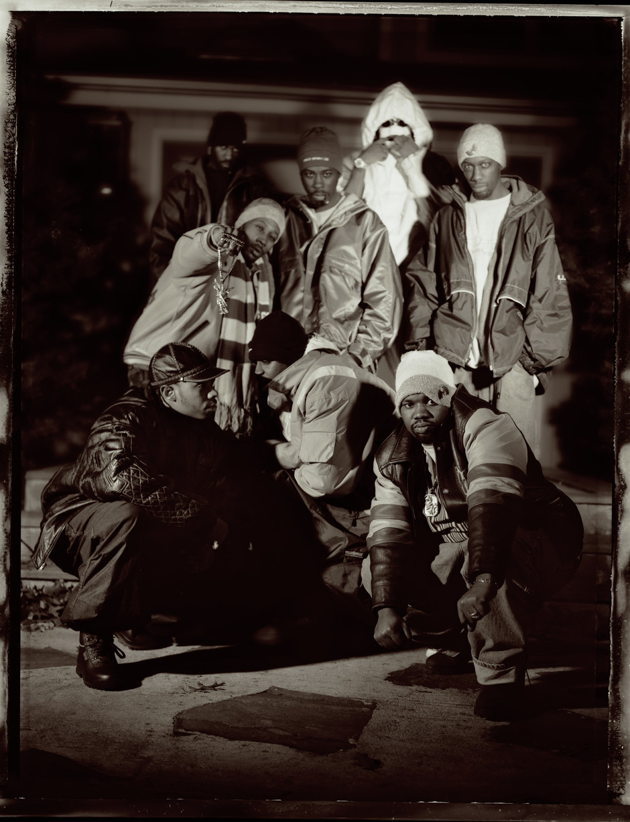
- with most of the Wu growing up in the projects of Staten Island it’s safe to say they all grew experiencing the same kind of struggles within their community whether it be experiencing racism as kids or having to sell crack cocaine on the block so as to make some kind of income.it even led to some of the wu members either getting incarcerated so they all looked to music as a way to make it out of the projects for they all viewed it as being organized in a way that prevented you from leaving. So in a way they all felt trapped in the hood and being apart of the wu-tang was their way out.
From the slums of Staten island

Slide 5

HOW KUNG FU & SOUL MUSIC INFLUENCED THE WU
Soul music and martial arts- growing up in the crack-era of New York City soul music from the 60’s-70s was pretty much the soundtrack of most of these guys childhood whether it be from what their parents played or what they found for themselves as hip hop was just finding its footing around that time. Members like ODB who were really fans of musicians like Marvin Gaye and Otis Redding and also having a mom as a singer and Then you also have others such as Masta Killa who also has a parent as a singer as well as being distant relatives of Marvin Gaye and nat turner so it’s safe to say that music was always apart of them.
Kung fu films-now although soul samples and music was evident throughout this album, it was mainly the Movie clips that gravitated with the audience at least to me. From the album name to Ghostface & Masta Killa being named after Kung fu films and characters in these films, it’s no surprise that the Wu was heavily influenced and inspired by these film. It’s also because of these movies that they started to regard their tongue as a sword and how if you were truly a lyricist then you had to be using the Wu tang sword.

Slide 6
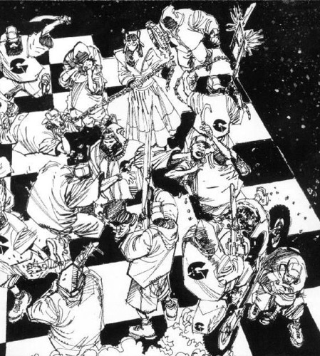
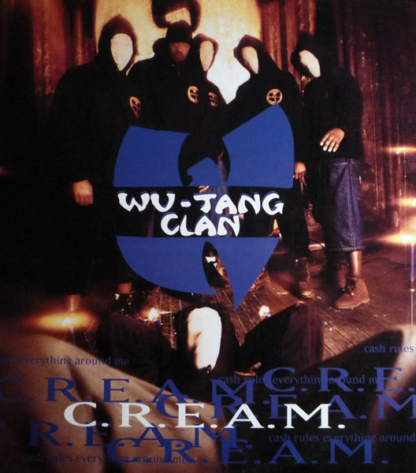

The album name ORIGINATED from the movies Enter the Dragon (1973) and The 36th Chamber of Shaolin(1978) which is also where Masta Killas name originated from. As for Ghostface Killah he got his name from a character in the movie The Mystery of Chess boxing” which is also clearly where the song “Da Mystery of chessboxin” comes from. As for the samples they usually appeared at the beginning of tracks most notably in songs such as "Bring the Ruckus”, Wu-Tang Clan Ain’t Nuthing t F’Wit”, “Da Mystery of Chessboxin’ etc. Add this with their gritty raw sounds and soulful samples like from songs like The Way We Were from Gladys Knight and the Pips on Can It Be All So Simple and The Charmels “As Long As I’ve Got You on their infamous song C.R.E.A.M, and you get the premise of what RZA’s production for the clan sounded like.

Slide 7




After the critical success of Enter the Wu-Tang album, the Wu wasn’t done there as RZA had a plan that would help launch most of their solo careers within the first 3-5 years while all on different record labels. the production for the first wave of the groups solo albums were usually done by RZA and within this time period albums like Tical by Method man, Return to the 36 chambers the Dirty Version by ODB, Raekwon’s Only Built for Cuban Linx, Liquid Swords By GZA and Ironman by Ghostface Killah was all released around that time which are usually all considered classics for the most part. During the latter years of the decade they were still as consistent putting out their second project as a group as well as other members putting out solo project’s. This run by the clan not only solidified them as an all-time great group but also legendary MC’s individually as well.
RZA’S FIVE YEAR PLAN

Slide 8




Following their success in the 1990’s it would’ve been hard for almost anyone to follow that up especially as a group. However Ghostface Killah started off that decade with what people consider his best album “Supreme Clientele”. And Wu-Tang ends up releasing their 3rd album, the W. Now although Wu-Tang was still in the limelight internal struggles of within the group as some wanted out of Wu-Tang Productions and others thought they were cheated out of money and others constantly dealing with the legal troubles. Their egos and money led to everyone going their separate ways with the last of them being Ol’Dirty Bastard who was in jail at the time. Once he got out, he ended up signing in Roc Nation but was met with his untimely death in 2004. The 2000s was not a fallout or fall off in my opinion but it was most surely a setback of a decade following their golden age of success during the 1990s.
TEARS FOR ODB (2000’S)

Slide 9


Throughout the years I don’t believe the Wu-Tang’s influence has been more apparent than in this decade of the 2010s. Following this album marking 25 years since it’s release, the Wu-Tang’s brand has continued to grow as they’ve gotten a documentary “Wu-Tang Clan: Of Mics Of Men” which is where I got most of my information from as I never paid that much attention to most of the information concerning this album as well as the clan altogether. It’s even led to a show being based off their early lives “Wu Tang: An American Saga. With the groups influence it’s even led to New York based rappers forming groups of their own such as Pro Era in Brooklyn and A$AP Mob. All in all With Enter the Wu-Tang Album it ended up not only being one of the best body of works of all time and launched several successful solo careers, it’s also changed the hip hop culture and will continue to remain timeless for years and decades to come.

