Slide 1

Delivering Effective Presentations
Joanna Wolfe, PhD
Director, Global Communication Center

Slide 2
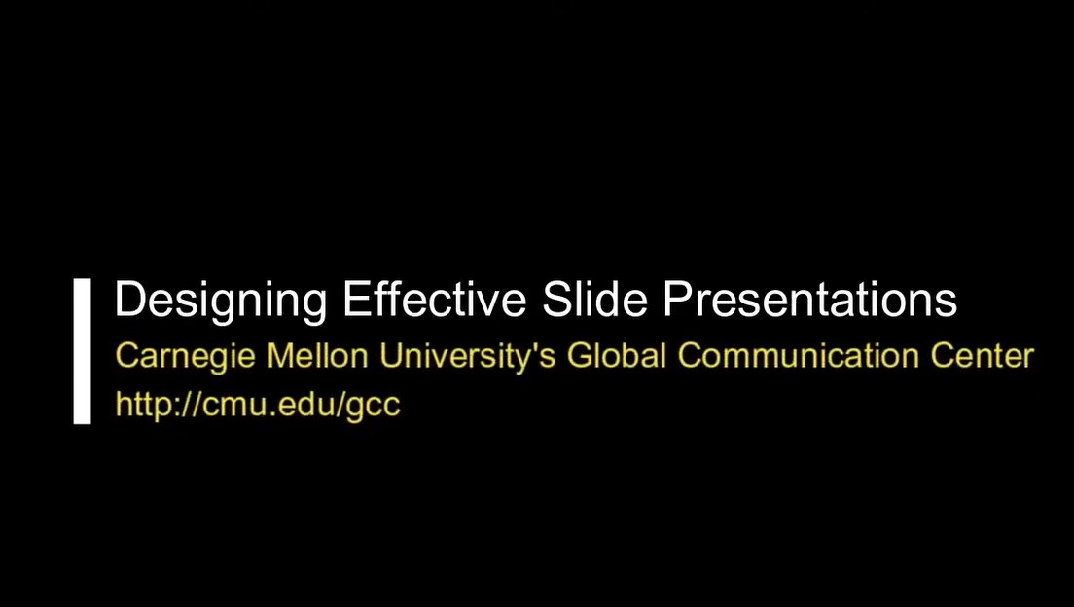
This presentation is meant to follow the “Designing Effective Slide Presentations” video
https://tinyurl.com/assertionevidence
https://youtu.be/kbdO7adBRFE?si=T_fC0op36AeBhpsZ

Slide 3

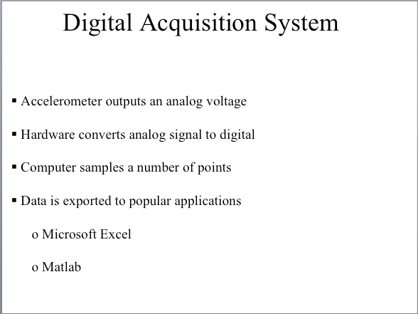
PowerPoint’s default designs wrongly push users to phrase headings and bulleted lists

Slide 4
In place of this default, we advocate a new model of slide design backed by research:
The Assertion-Evidence Model
Notes:
AE is a design that uses a sentence heading and visual evidence

Slide 5
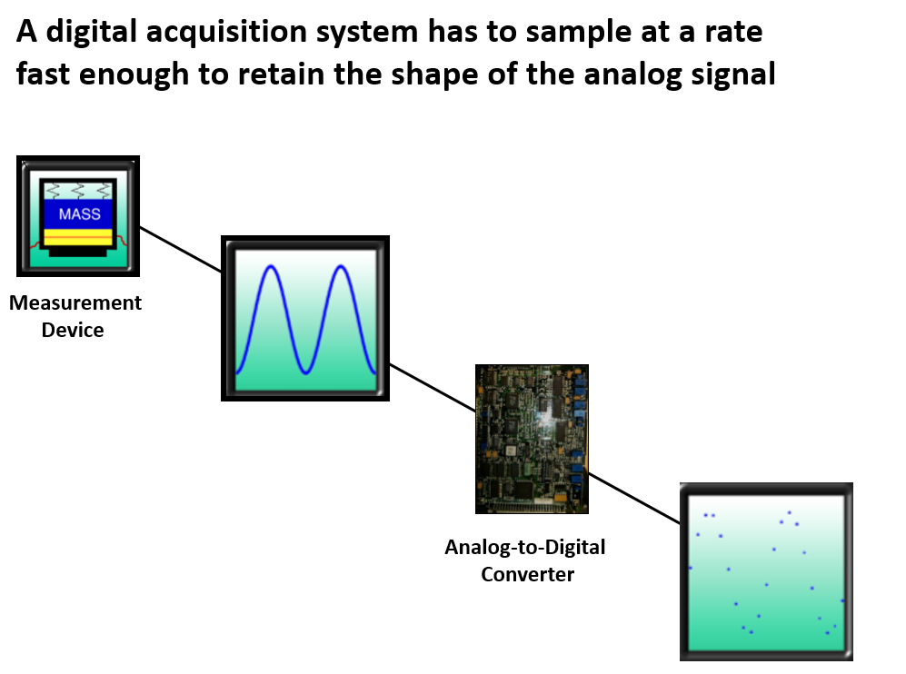
The assertion-evidence model combines complete sentence headings and visual evidence

Slide 6
An ideal sentence heading is two lines long, left aligned, and sentence case (first letter only capitalized).
Notes:
Font face should be unremarkable and professional: Arial, Calibri, Helvetica, etc.
Heading size should be ~32pt font for Powerpoint and ~24pt font for Google slides.
The difference is because PowerPoint defaults to a larger screen size than Google slides (13.333 x 7.5 inches vs. 10 x 5.625 inches)

Slide 7
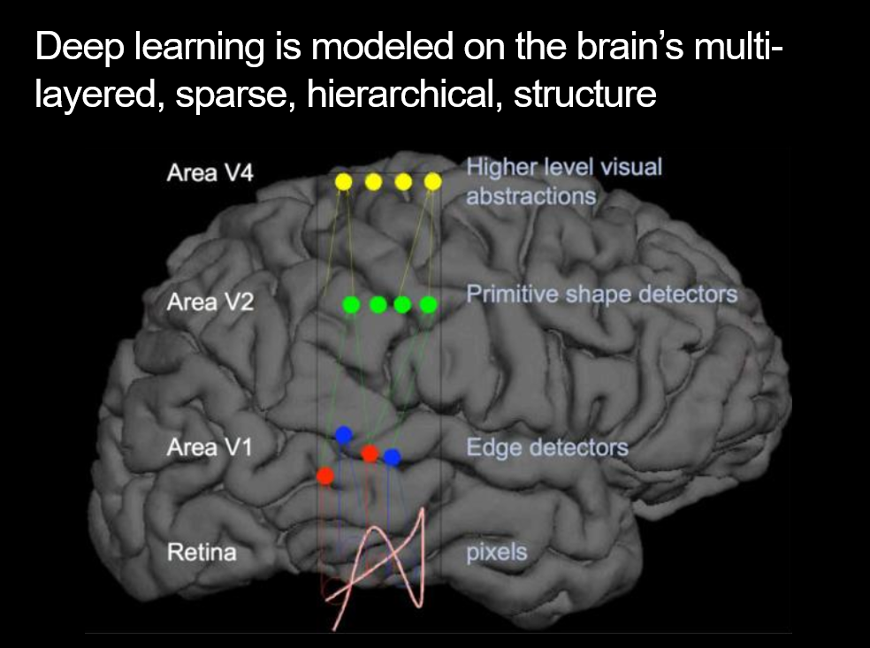
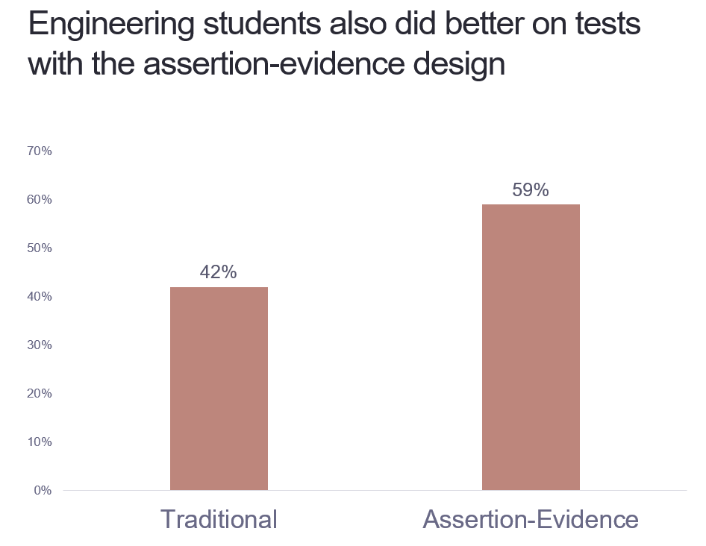
We use sentence headings with both topical and data-driven slides

Slide 8
Sometimes it is hard to think of a visual for a topic-driven slide

Slide 9
In this case, consider using just a single sentence rather than a “decorative” visual

Slide 10
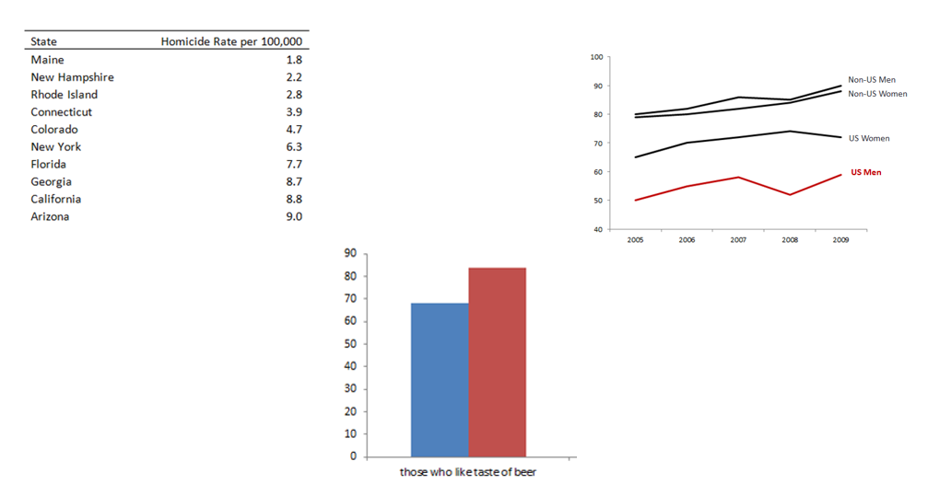
But data-driven slides should always have a visual and a main sentence assertion

Slide 11
The following slides use the assertion-evidence model to summarize research on its effectiveness
Notes:
AE is a design that uses a sentence heading and visual evidence

Slide 12
Students in a geological sciences class did better on tests with the assertion-evidence design
Notes:
70% correct; same content with a different model: 82%
Alley, M., Schreiber, M., & Muffo, J. (2005, October). Pilot testing of a new design for presentation slides to teach science and engineering. In Proceedings Frontiers in Education 35th Annual Conference (pp. S3G-7). IEEE.

Slide 13
Engineering students also did better on tests with the assertion-evidence design
Notes:
Garner, J. K., Alley, M., Sawarynski, L. E., Wolfe, K. L., & Zappe, S. E. (2011, January). Assertion-evidence slides appear to lead to better comprehension and recall of more complex concepts. In ASEE Annual Conference and Exposition, Conference Proceedings.
Garner, J., & Alley, M. (2013). How the design of presentation slides affects audience comprehension: A case for the assertion-evidence approach. International Journal of Engineering Education, 29(6), 1564-1579.

Slide 14
Engineering students who created assertion-evidence slides received higher analysis scores (6 pt scale)
Notes:
Analysis scores on a 6-pt scale
Garner, J. K., & Alley, M. P. (2016). Slide structure can influence the presenter’s understanding of the presentation’s content. International Journal of Engineering Education, 32(1), 39-54.

Slide 15
CMU grad students using assertion-evidence gave more highly rated conference presentations (6 pt scale)
Notes:
Wolfe, J., Shanmugaraj, N., Reineke, J., Caton Peet, L., & Moreau, C. P. (2024). Advancing the knowledge base on effective presentation slide design: Three pilot studies. Journal of Technical Writing and Communication, 54(3), 235-264.

Slide 16
Exercise A

Slide 17
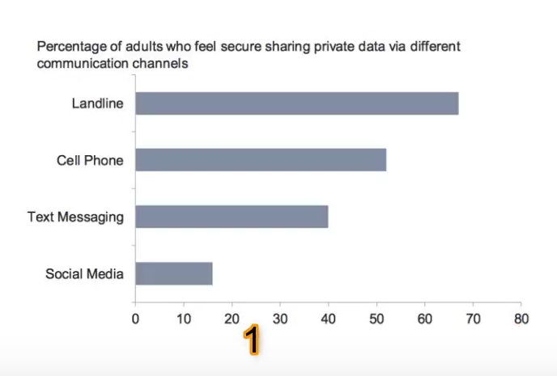

Slide 18
Adults feel most secure sharing private data on landline phones and least secure on social media

Slide 19
Adults feel most secure sharing data on older technologies

Slide 20
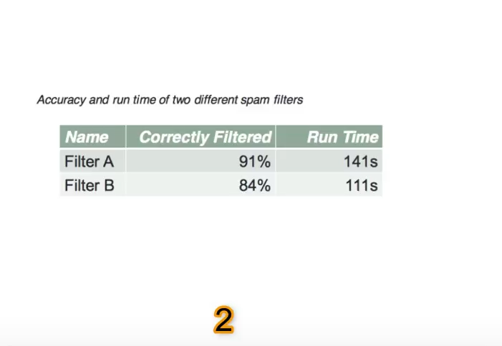

Slide 21
Filter A is more accurate, but slightly slower, than Filter B

Slide 22
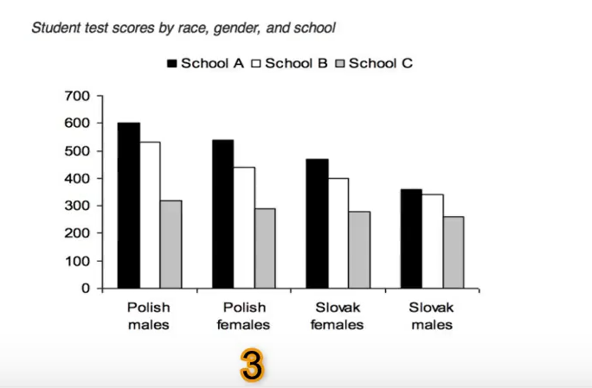

Slide 23
Polish males had higher test scores than other groups

Slide 24
Polish students outperformed Slovak students at schools A and B

Slide 25
Students at school C did the worst on tests regardless of gender or ethnicity

Slide 26
Exercise B

Slide 27
Results
Table 1: Results of Fog Warning System Implementation
Implementation | Before | After
Average vehicle speed | 45.5 mph | 45.7 mph
Standard deviations in vehicle speed | 9.4 mph | 7.2 mph
Notes:
How can you revise this slide to reflect the assertion-evidence model?

Slide 28
The fog warning system produced safer road conditions by decreasing speed deviations
Implementation | Before | After
Average vehicle speed (in mph) | 45.5 | 45.7
Standard deviations in vehicle speed (in mph) | 9.4 | 7.2
Notes:
See how much cleaner that looks without all the gridlines

Slide 29
How to optimize workplace efficiency
Working in time blocks maximizes efficiency
  Most individual activities can be completed in 50 min or less
  Most individual meetings can be conducted in 20 min.
Schedule breaks between time blocks
  A ratio of 50 minutes working to 10 minutes break is shown to be the most conducive to productivity
Plan to reflect on tasks after 3 blocks of time
  Reflect on how you feel about your progress
  Re-read notes
  Plan to improve next time
Alternate sitting with walking and standing
  For every 20 minutes you spend sitting, you should spend 8 minutes standing and 2 in motion

Slide 30
To work efficiently, break your time up into blocks
Time blocks
maximize
efficiency
Schedule breaks between time blocks
Reflect after three blocks
Individual activities take 50 min or less
Individual meetings take 20 min.
Every hour, work 50 minutes and take a break for 10
Alternate sitting with walking (sit 20 min., stand 8, be in motion 2)
Reflect how you feel about your progress
Re-read notes
Make an improvement plan

Slide 31
To work efficiently, break your time up into blocks
Chunk your time into blocks
(e.g., 50 min 20 min)
Schedule breaks between time blocks
Reflect after three blocks
Notes:
Individual activities take 50 min or less; Individual meetings take 20 min
Every hour, work 50 minutes and take a break for 10
Alternate sitting with walking (sit 20 min., stand 8, be in motion 2)
Re-read notes; make an improvement plan

Slide 32


Planning your time into blocks can optimize efficiency
50 min work 10 min break

Slide 33

Reflect after three blocks of time

Slide 34

Alternate sitting with walking and standing
20 min 8 min 2 min

Slide 35
Formal vs. Informal Email
Formal
  Audience
    People outside company
    Superiors
  Word choice
    “Dear”, “Sincerely:
Informal
  Audience
    People inside company at similar level
  Word choice
    Formal greeting not necessary
    Short

Slide 36
Match the tone and word choice of your email to your audience
Audience:
People outside company or superiors
Audience:
People inside company at similar level
OR
Tone:
Formal
Tone:
Informal
Word choice:
“Dear,” “Sincerely”
Word choice:
Short greeting (optional)

Slide 37
The distinction between formal and informal email is important for new employees to grasp
Formal
Informal
Audience
People outside company, superiors
People inside company at a similar level
Word Choice
‘Dear’
‘Sincerely’
Formal greeting not necessary, usually short

Slide 38
Additional Resources
Video (and exercises) on the Assertion-Evidence model: https://tinyurl.com/assertionevidence
More videos, learning modules, and research publications from the former Global Communication Center: https://sites.google.com/andrew.cmu.edu/gcc/home

Slide 39
References
Alley, M., Schreiber, M., & Muffo, J. (2005, October). Pilot testing of a new design for presentation slides to teach science and engineering. In Proceedings Frontiers in Education 35th Annual Conference (pp. S3G-7). IEEE.
Garner, J., & Alley, M. (2013). How the design of presentation slides affects audience comprehension: A case for the assertion-evidence approach. International Journal of Engineering Education, 29(6), 1564-1579.
Garner, J. K., & Alley, M. (2016). Slide structure can influence the presenter’s understanding of the presentation’s content. International Journal of Engineering Education, 32(1), 39-54.
Garner, J. K., Alley, M., Sawarynski, L. E., Wolfe, K. L., & Zappe, S. E. (2011, January). Assertion-evidence slides appear to lead to better comprehension and recall of more complex concepts. In ASEE Annual Conference and Exposition, Conference Proceedings.
Wolfe, J., Reineke, J., Stump, K. (2026). “Breaking from PowerPoint’s Defaults: A New Workshop Model Encourages Presenters to Adopt Best Practices in Presentation Slide Design.” in Liminality: The Work of Resilience in Technical Communication. WAC Clearinghouse, 2026. https://doi.org/10.37514/TPC-B.2026.2869.2.06
Wolfe, J., Shanmugaraj, N., Reineke, J., Caton Peet, L., & Moreau, C. P. (2024). Advancing the knowledge base on effective presentation slide design: Three pilot studies. Journal of Technical Writing and Communication, 54(3), 235-264.

